Slide 1


Everway SDET
Shift-Left Program
August / September 2026

Slide 2





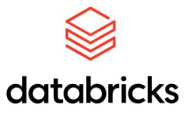
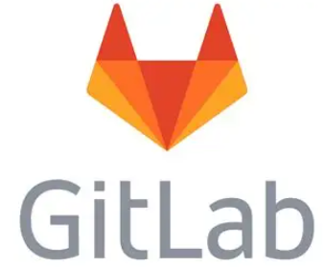


Meet your instructor
Ray Coulstock​
Senior Technical Trainer
25+ years of teaching
@ Software Venders
@ Colleges
@ Awarding Bodies
12+ countries
1,000+ happy students

Slide 3

Session timings
Start and finish
13:00 – 17:00
Breaks
14:00 – 14:10
15.50 – 16:00

Slide 4

Housekeeping
Feel free to interrupt
the trainer at any
time - you don’t
need to
raise your
hand!
Keep your
camera on
Stay muted
but be ready
to regularly un-
mute and join in
Turn phones to silent, and close your email

Slide 5


Shift-Left Program
What we are going to cover in this program.
Phase 1 – Think like an SDET
Shift-left, quality ownership, Testing Pyramid, Playwright foundations.
API testing with Postman, AI-enabled testing, assessment.
Phase 2 – Engineer a quality solution
Playwright suites, AI in practice, Pact, JMeter.
Build a broader automated testing strategy rather than simply automate UI tests.
Developer coaching, testability, exploratory testing.
Operate as an embedded SDET who improves the team’s engineering practices.
Phase 3 - Hackathon
Coming Soon.

Slide 6
Phase 1 Day 1
Shift-Left Thinking: Quality Across the SDLC
The Testing Pyramid in Practice
Playwright Foundations (TypeScript, CI/CD integration) — pre-requisite for Phase 2

Slide 7
From QA Engineer to SDET
Today's question: How do we build confidence into a feature?
How do we build confidence/test now ?
How CAN we build confidence/test in the future ?

Slide 8

Demo: Neueda VM
Let’s investigate the Neueda VM and the training project we are working with.
Find the github repo
Working with codespaces.

Slide 9
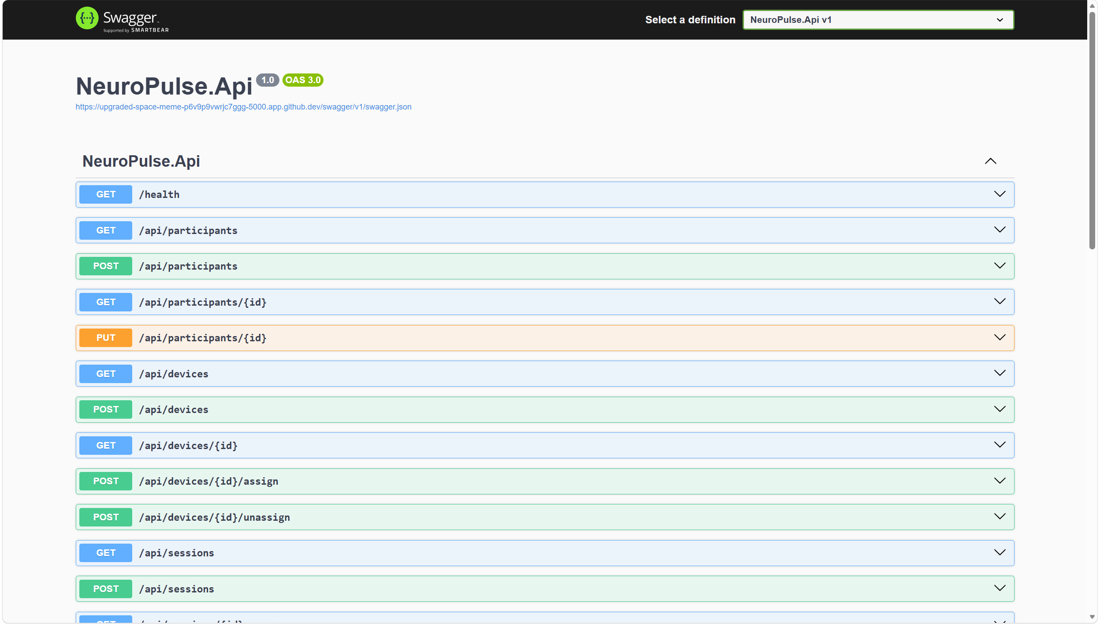
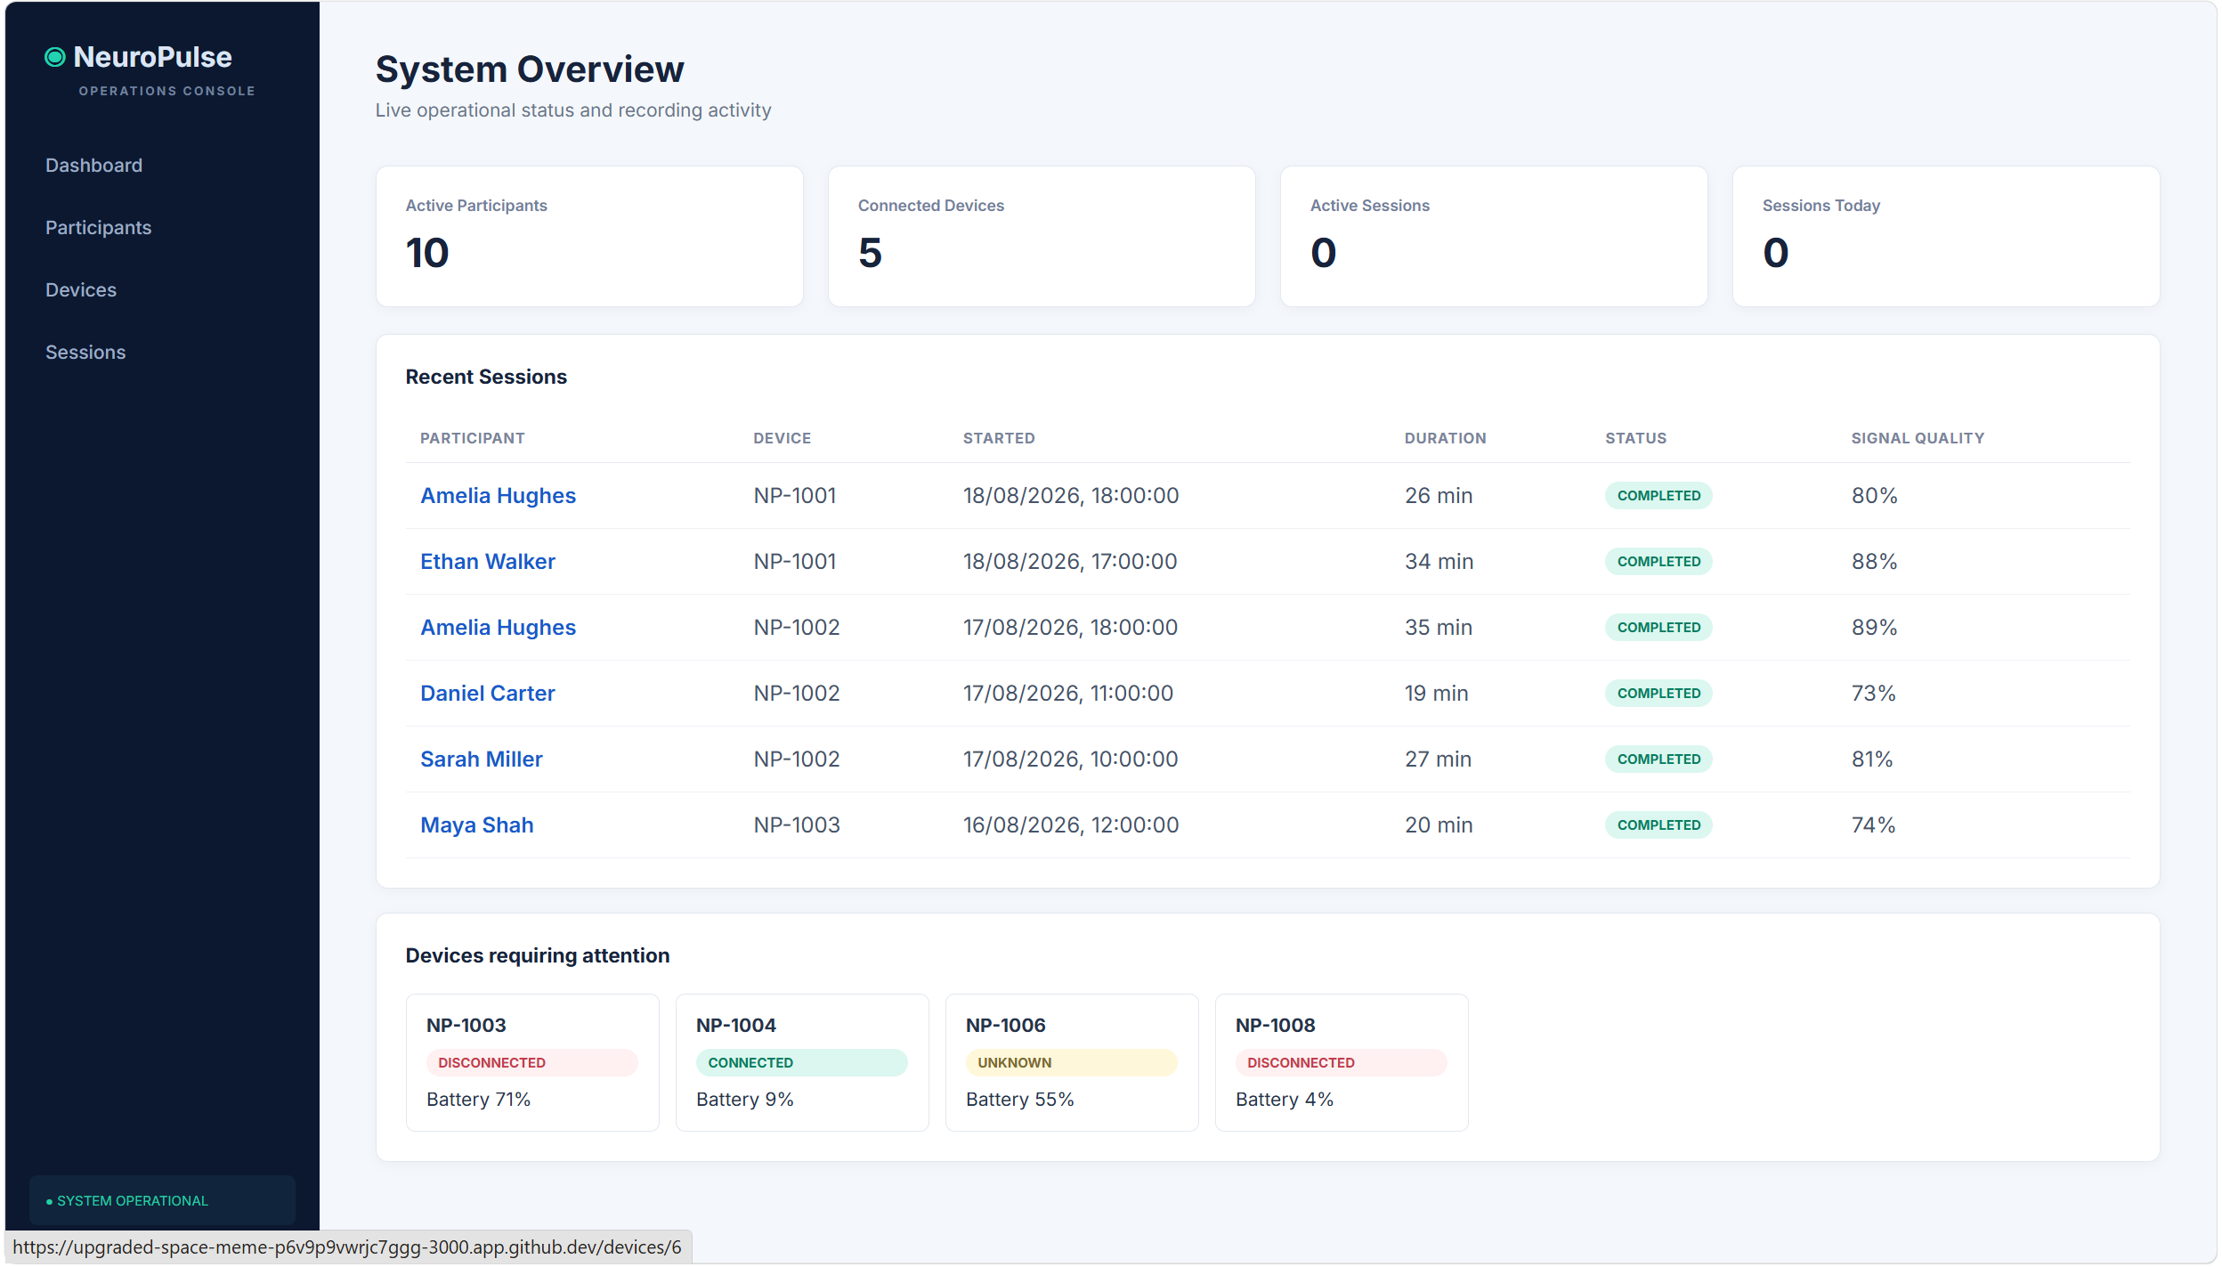
Our Training App - NeuroPulse
NeuroPulse API
NeuroPulse React UI
Device Simulator

Slide 10
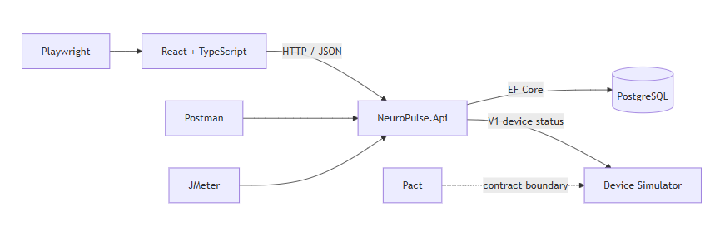
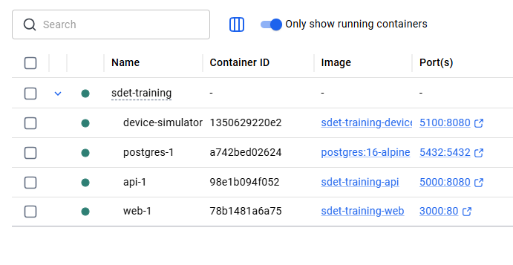
NeuroPulse Architecture

Slide 11
Where Are We Going?
QA Engineer
(Did it work?)
Automation Engineer
(Can we check it repeatedly?)
SDET
(How should we build confidence?)
Quality Advocate
(How can the team prevent risk?)
Software Development Engineer in Test
Not: “a tester who writes automation”

Slide 12
Today's Outcomes
By the end, you can:
identify quality interventions across the SDLC;
choose an appropriate test level;
write a small Playwright test with an intent-focused locator;
explain auto-waiting and test independence;
use failure evidence to begin a diagnosis.

Slide 13
The Role Is Changing
Detection | Prevention
Test after implementation | Shape acceptance examples early
Report a defect | Expose an ambiguous rule
Add another UI check | Choose the cheapest useful signal
Own “the testing” | Grow team quality capability
Shift-left means earlier feedback—not moving every test earlier.

Slide 14
Shift-Left Thinking: Quality Across the SDLC

Slide 15

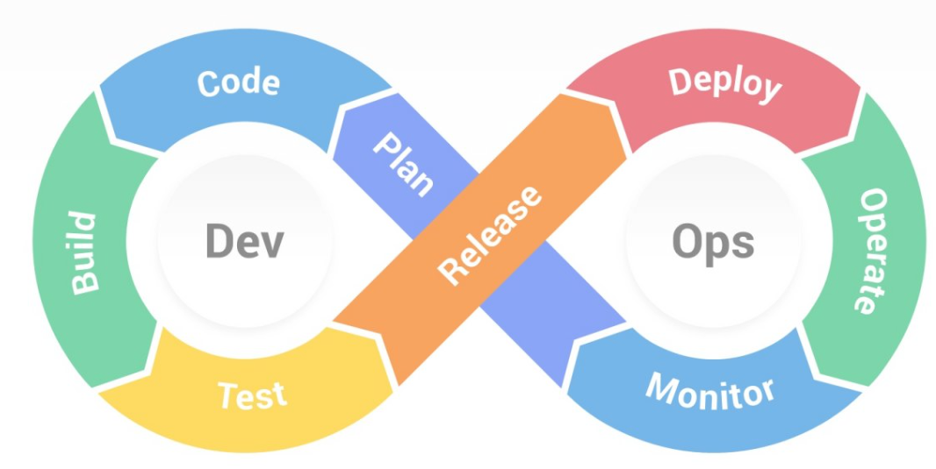
Quality Across the SDLC
Where could quality questions go?
Where could an SDET change the outcome—not just inspect it?

Slide 16

Activity 1 — Quality Across the SDLC
Purpose
Identify where an SDET can prevent, detect, and diagnose risk.
NeuroPulse context
Trace a proposed change to Start Recording from idea through production.
Estimated time: 20 minutes

Slide 17
Activity 1 Debrief — Who Owns Quality Across the SDLC?
Where was prevention possible ?
Which feedback could arrive fastest ?
Where did specialist testing expertise add value ?
What still needs observation after release ?

Slide 18
The Testing Pyramid in Practice

Slide 19
The Testing Pyramid Is a Conversation
UI
API
Integration
Unit Tests
Fewer, slower and broad confidence
Many, fast and isolated
Optimise the feedback portfolio, not the shape.

Slide 20
Where Could “Start Recording” Live?
Question | Candidate signal
Battery 9% is rejected | service/unit or API
Simulator V1 shape is understood | contract
Session persists correctly | integration/API
Technician completes the journey | focused UI
One behaviour may justify more than one signal—for different risks.

Slide 21
Activity 2 — Where Should This Test Live?
Purpose
Classify risks by the most useful testing level and defend the trade-off.
NeuroPulse context
Participants, device assignment, recording rules, telemetry, and simulator status.
Estimated time: 20 minutes

Slide 22
Debrief — A Placement Checklist
What risk are we addressing ?
What is the lowest level that can expose it faithfully ?
How fast and diagnostic is the feedback ?
What wiring remains untested ?
Is the maintenance cost proportionate ?

Slide 23


Time to refill
(Tea break)

Slide 24
Playwright Foundations (TypeScript, CI/CD integration)

Slide 25
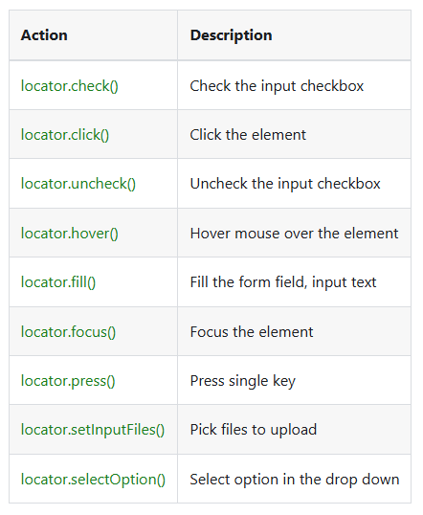

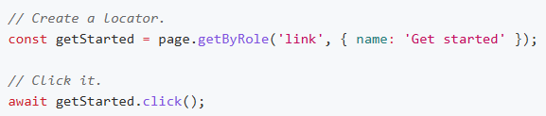
Playwright – Locators and Actions
https://playwright.dev/docs/writing-tests

Slide 26
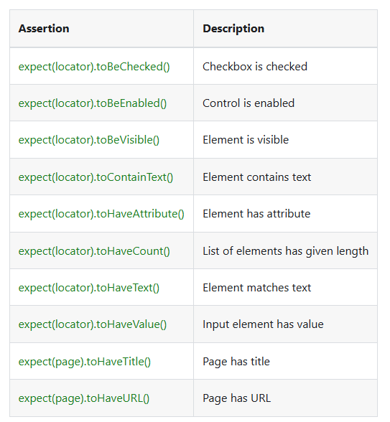
Playwright - Assertions

Slide 27
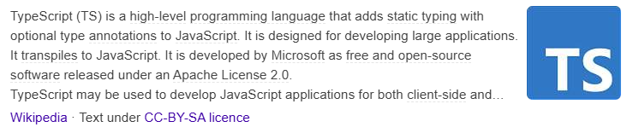
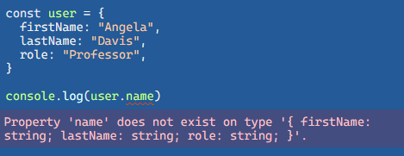
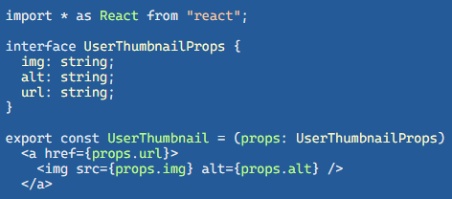
Typescript
https://www.typescriptlang.org/

Slide 28
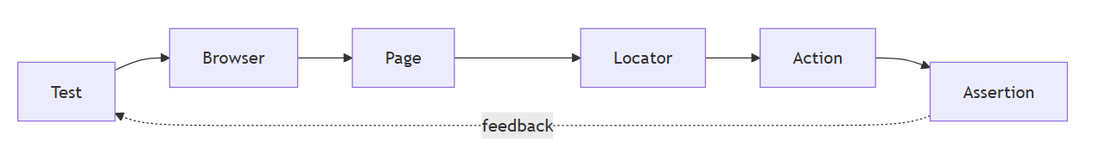
Playwright: A Mental Model
Locate intent → interact like a user → observe behaviour

Slide 29
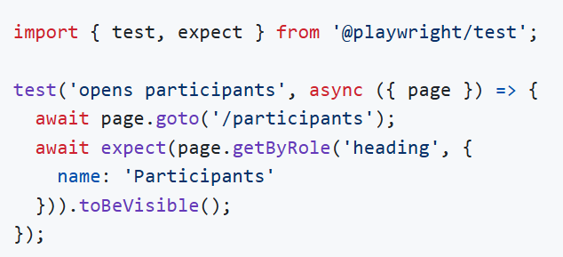
A First NeuroPulse Test
Arrange → Act → Assert (even when the lines overlap)

Slide 30
Activity 3 — Your First NeuroPulse Test
Purpose
Create one readable browser test around an observable user outcome.
NeuroPulse context
Use a Participants, Devices, or Sessions page from the React application.
Estimated time: 25 minutes

Slide 31
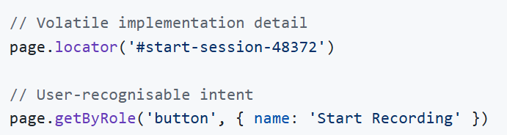
What Makes a Locator Resilient?
Preference guide: role/label → text → test ID → CSS when justified

Slide 32
Accessibility and Testability Reinforce Each Other
A real <button> has role, keyboard behaviour, and focus semantics.
A labelled input is usable by people and automation.
Intent-focused locators survive layout and styling changes.
A failing semantic locator may reveal a product concern.
Would you change the test—or improve the interface?

Slide 33
Activity 4 — Find the Most Resilient Locator
Purpose
Compare selector choices and identify product testability signals.
NeuroPulse context
Search Participants, filter Devices, and inspect the Start Recording control.
Estimated time: 15 minutes

Slide 34
Time to refill
(Tea break)

Slide 35
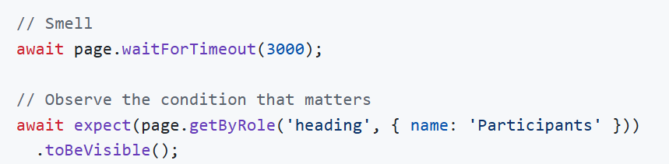
Waiting in an Asynchronous UI
Action requested
↓ Playwright checks actionable state
Click / fill / navigate
↓ application fetches / renders
Web-first assertion retries until timeout

Slide 36
Activity 5 — Why Is This Test Flaky?
Purpose
Replace timing guesses with observation of a meaningful condition.
NeuroPulse context
Investigate navigation or session status while simulator latency changes.
Estimated time: 15 minutes

Slide 37
Test Independence Is Designed
Independent tests:
establish or request known state;
do not rely on execution order;
own unique or resettable data;
clean up only what they own;
can run alone and in parallel.
A retry can hide shared-state coupling.

Slide 38
Time to refill
(Tea break)

Slide 39
Debug the System, Not Just the Line
Evidence | Useful question
Assertion message | What differed?
Screenshot | What was visible?
Trace | What actions, DOM, and network preceded it?
HTML report | Is failure isolated or patterned?
API/service logs | Did the dependency fail?
Failure location ≠ root cause

Slide 40
Activity 6 — Investigate a Failed Test
Purpose
Build a causal hypothesis from Playwright evidence rather than guessing.
NeuroPulse context
Use a recording or navigation failure with report, screenshot, and trace evidence.
Estimated time: 10 minutes

Slide 41

End of Day 1 — Good SDET Questions
What behaviour matters ?
Where should it be tested ?
How quickly can the test give feedback ?
Will the test remain reliable ?
What evidence will help us diagnose failure ?

Slide 42
Thank you

Slide 43
Phase 1 Day 2
API Testing Essentials (Postman)
Introduction to AI-Enabled Testing
Phase 1 Assessment

Slide 44
Phase 2 Day 3
Build Automation Suites in Playwright (Page Object Model, component testing)
AI in Practice
Contract Testing with PACT
Load Testing with JMeter

Slide 45
Phase 2 Day 4
Developer Coaching in Practice
Designing for Testability
Exploratory Testing as a Craft
Phase 2 Assessment

Slide 46
Thank you

